Slide 1
Maven
Maven can be used when building project with POM (Page Object Model) when working on big projects.
Maven is the latest build testing tool.
Maven is a project build or project management tool. It is used to check the compilation issues between framework components whenever multiple test engineer integrates their files into the same framework.
Maven has new features like dependency, which is used to download the dependency jar from the internet before the test execution.
Maven Eclipse Plug-in
It is a default plug-in for the latest Eclipse versions like Mars, Luna, oxygen, which is used to create a Maven project through Eclipse.
Installing Maven plug-in for Eclipse and use it with Selenium TestNG
Most of the time, Maven plug-in is automatically installed in the Eclipse, but if it is not present, we will go to the Eclipse Market Place and search for Maven and download the M2E integrated version from there.

Slide 2
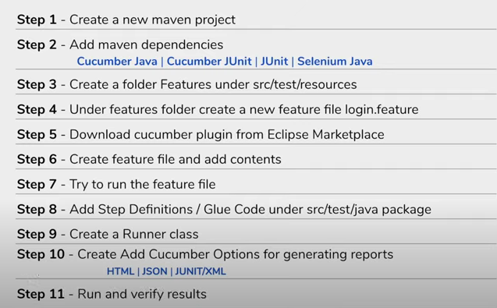
Steps to create Maven project

Slide 3
Maven Dependencies
<dependencies>
<dependency>
<groupId>io.cucumber</groupId>
<artifactId>cucumber-java</artifactId>
<version>5.7.0</version>
</dependency>
<dependency>
<groupId>junit</groupId>
<artifactId>junit</artifactId>
<version>4.13</version>
<scope>test</scope>
</dependency>
<dependency>
<groupId>io.cucumber</groupId>
<artifactId>cucumber-junit</artifactId>
<version>5.7.0</version>
<scope>test</scope>
</dependency>
</dependencies>

Slide 4
Feature file
@test
Feature: feature to test login functionality
@test
Scenario: login with valid credentials
Given user is on login page
When user enter username and password
And user click on login button
Then user navigated to home page

Slide 5
Step Definition
@Given("user is on login page")
public void user_is_on_login_page() {
System.out.println("inside step- login page");
}
@When("user enter username and password")
public void user_enter_username_and_password() {
System.out.println("inside step- enter username and password");
}
@And("user click on login button")
public void user_click_on_login_button() {
System.out.println("inside step- click on login button");
}
@Then("user navigated to home page")
public void user_navidated_to_home_page() {
System.out.println("inside step- navigated to home page");
}

Slide 6
Test Runner Class
import org.junit.runner.RunWith;
import io.cucumber.junit.CucumberOptions;
import io.cucumber.junit.Cucumber;
@RunWith(Cucumber.class)
@CucumberOptions(features= "src/test/resources/Features", glue={"StepDef"},
monochrome = true,
plugin={"pretty", "html:Target/HTMLReport"},
tags="@test"
)
public class testrunner {
}

Slide 7
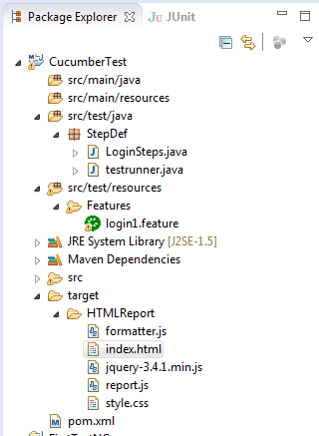
Framework Structure

